Slide 1
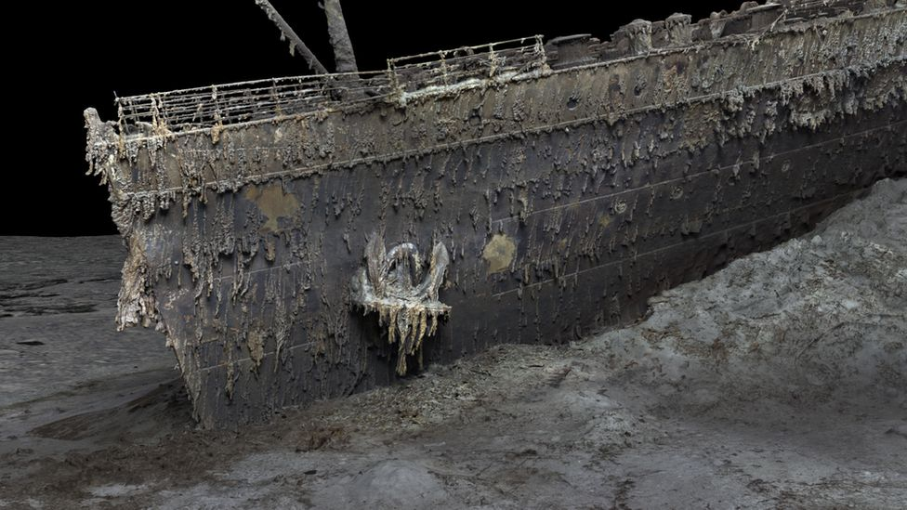
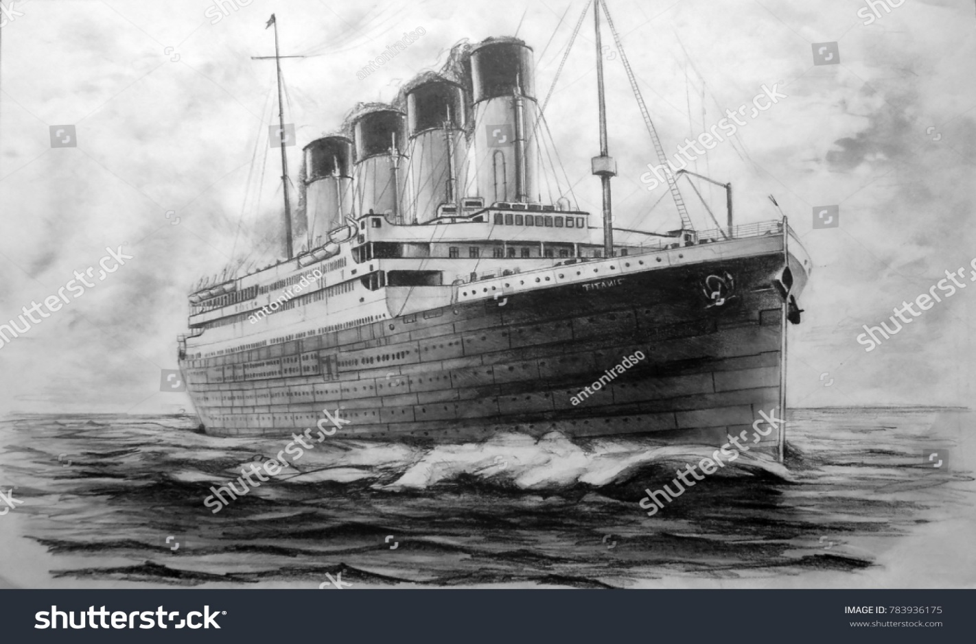
TITANIC SURVIVAL PREDICTION USING MACHINE LEARNING

Slide 2
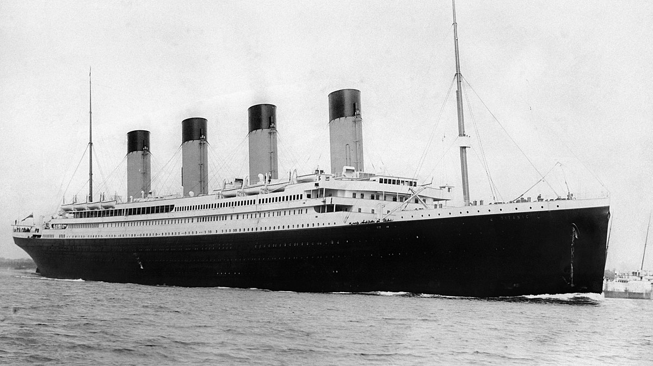
This is the story of a ship that embarked on a maiden voyage, brimming with hope and bound for glory, only to meet a heartbreaking destiny in the icy waters of the North Atlantic.
The RMS Titanic, a legendary ocean liner that met a tragic fate, remains an enduring symbol of human ambition, engineering marvel, and profound loss. Launched on May 31, 1911, the Titanic was the largest and most luxurious ship of its time, designed to be a testament to human ingenuity and an unparalleled experience in transatlantic travel.
This is the story of a ship that embarked on a maiden voyage, brimming with hope and bound for glory, only to meet a heartbreaking destiny in the icy waters of the North Atlantic.
PROBLEM DEFINITION :
This problem involves developing a model that can analyze various features of the passengers, such as age, gender, ticket class, and embarkation point, to determine their likelihood of surviving the disaster.
By leveraging a dataset containing information about the Titanic's passengers and their survival outcomes, machine learning algorithms can be trained to accurately predict survival probabilities.
This application not only showcases the power of machine learning in historical analysis but also provides insights into the factors that influenced survival on that ill-fated voyage.

Slide 3
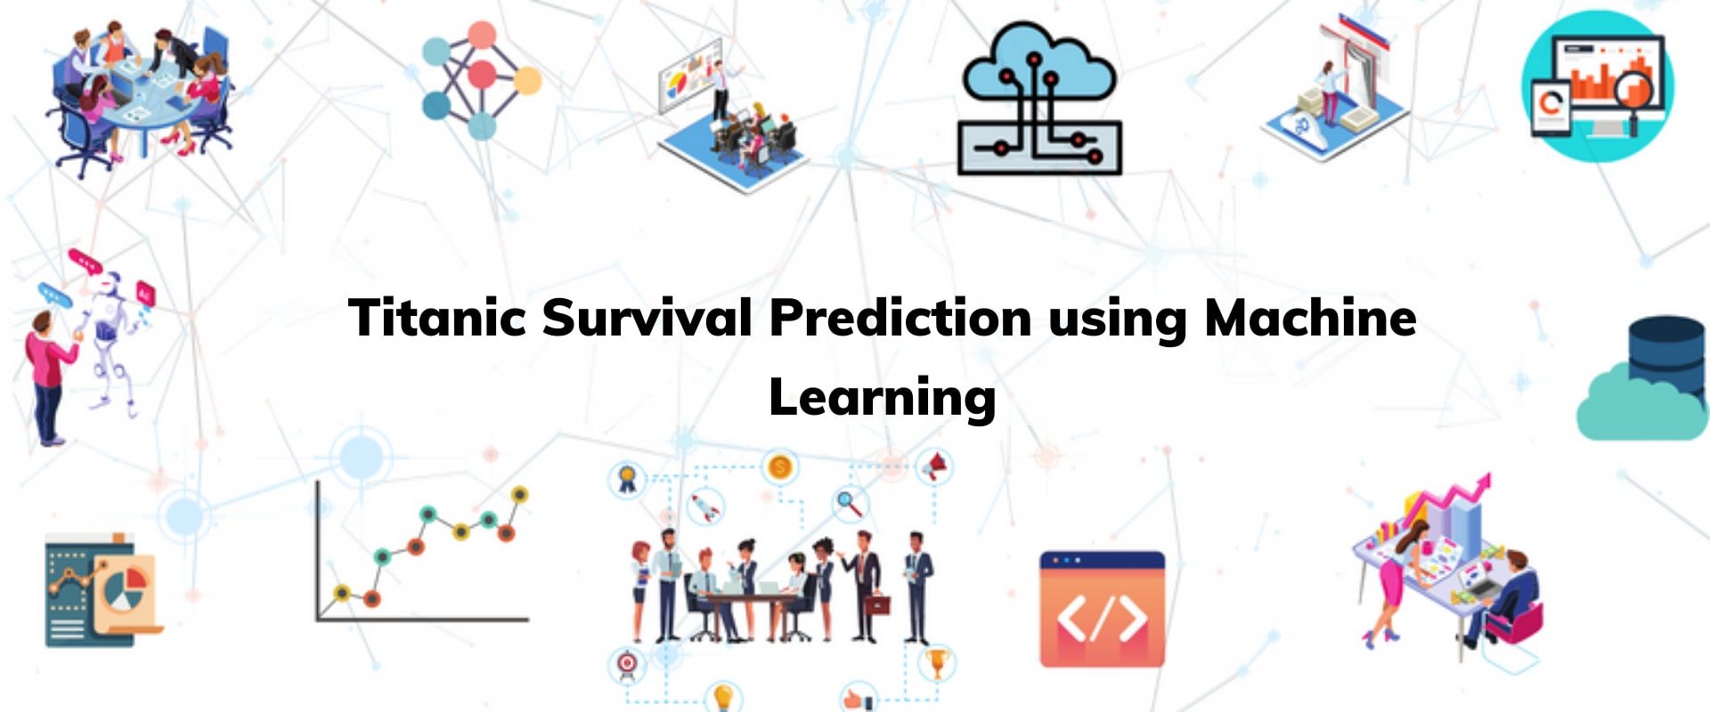
STEP BY STEP ALGORITHM
ACQUIRE DATA
FEATURE SELECTION
HISTOGRAM OF OBSERVATIONS
DISCARDING IRRELEVANT FEATURES
CREATE NEW FEATURES
MODEL TRAINING
EVALUATION USING REQUIRED PARAMETERS.

Slide 4
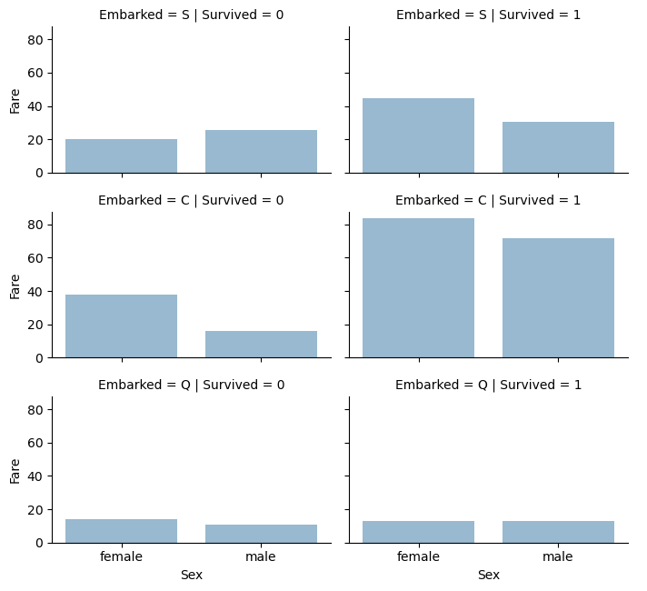
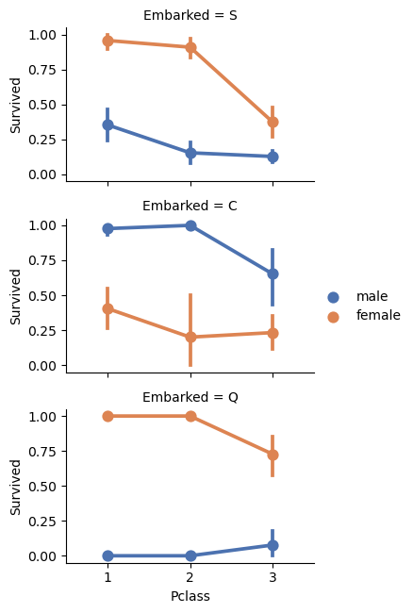
PLOTS IN CODE
EMBARKED PORTS VS SURVIVAL
C – CHERBOURGH
S - SOUTHAMPTON
Q – QUEENSTOWN
0 – DEATH ; 1 – SURVIVED
GENDER VS SURVIVAL BASED ON
SOURCE of embarkment and fare paid.
SOURCE OF EMBARKMENT AND CLASS OCCUPIED

Slide 5
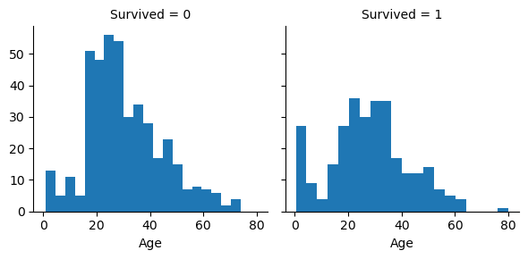
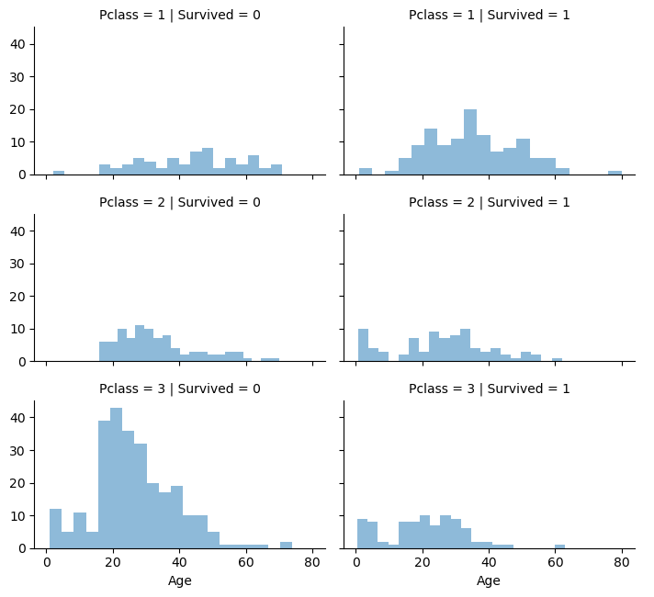
ADDITIONAL PLOTS
AGE VS SURVIVED
Age vs survived based on class occupied

Slide 6
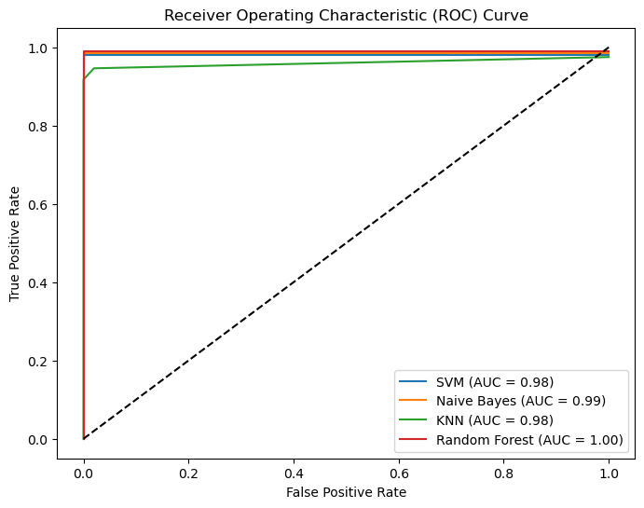
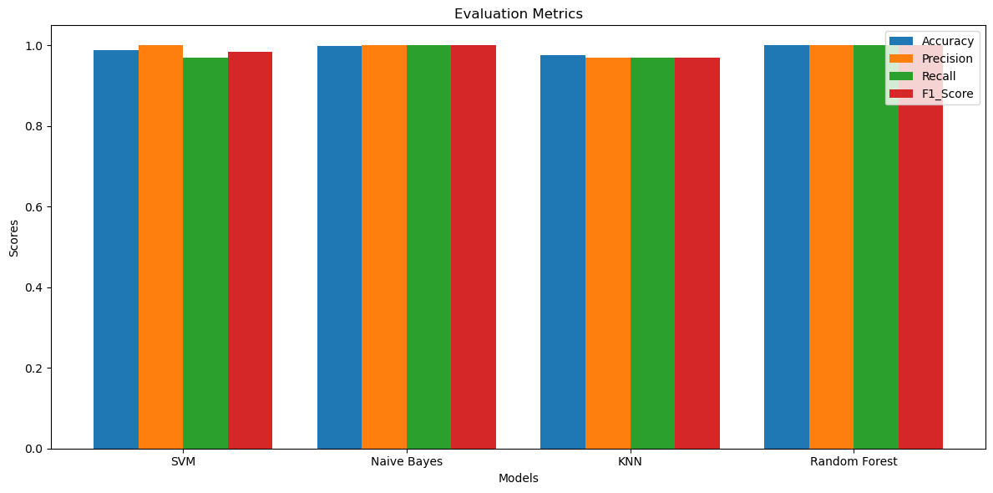
PLOTS AFTER MODEL TRAINING
THE ROC CURRVE WAS OBTAINED.
The model we obtained is then trained with different classifiers and regression models inclusive of Support VECTOR MACHINE , NAÏVE BAYES , KNEAREST NEIGHBOUR AND RANDOM FOREST.
RANDOM FOREST GAVE US THE BEST PERFORMANCE METRICSCORES.

Slide 7
HOW THE CRASH COULD HAVE BEEN AVOIDED
officer David Blair, who held the key to the Titanic’s store of binoculars in his pocket, was transferred off the ship and forgot to hand over the key to the officer who replaced him.
a lookout on the Titanic said binoculars might have helped them spot and dodge the iceberg in time.
No matter what caused the Titanic to sink, such a massive loss of life could probably have been avoided if the ship had carried sufficient lifeboats for its passengers and crew.
the White Star liner left Southampton with only 20 lifeboats, the legal minimum, with a total capacity of 1,178 people.
Titanic was constructed with transverse bulkheads (i.e. walls) to divide the ship into 16 watertight compartments, which could be sealed off with doors operated either manually or remotely from the bridge.
The lookouts had no binoculars.
There weren’t enough lifeboats.
The ship's watertight bulkheads could have been extended and fully sealed to reduce the risk of flooding

Slide 8
CONCLUSION
In conclusion, the use of machine learning for Titanic survival prediction has proven to be a valuable approach in understanding and analySing the factors that influenced survival during the tragic event. By leveraging the available dataset and training predictive models, we can accurately estimate the likelihood of survival for passengers based on their individual characteristics.
Through this application, we have gained insights into the importance of features such as age, gender, ticket class, and embarkation point in determining survival outcomes. The models have revealed patterns and relationships that highlight the social dynamics and biases prevalent during the time of the Titanic disaster.
The predictive models not only provide a historical analysis of the event but also enable the estimation of survival probabilities for individuals not present in the original dataset. This capability allows researchers to explore hypothetical scenarios and understand how different conditions could have affected survival rates.
Overall, the use of machine learning in Titanic survival prediction has offered a powerful tool for uncovering hidden patterns, making accurate predictions, and enhancing our understanding of the factors that influenced the fate of the passengers. It serves as a reminder of the potential of machine learning to contribute to historical analysis and provide valuable insights into significant events from the past.

Slide 9
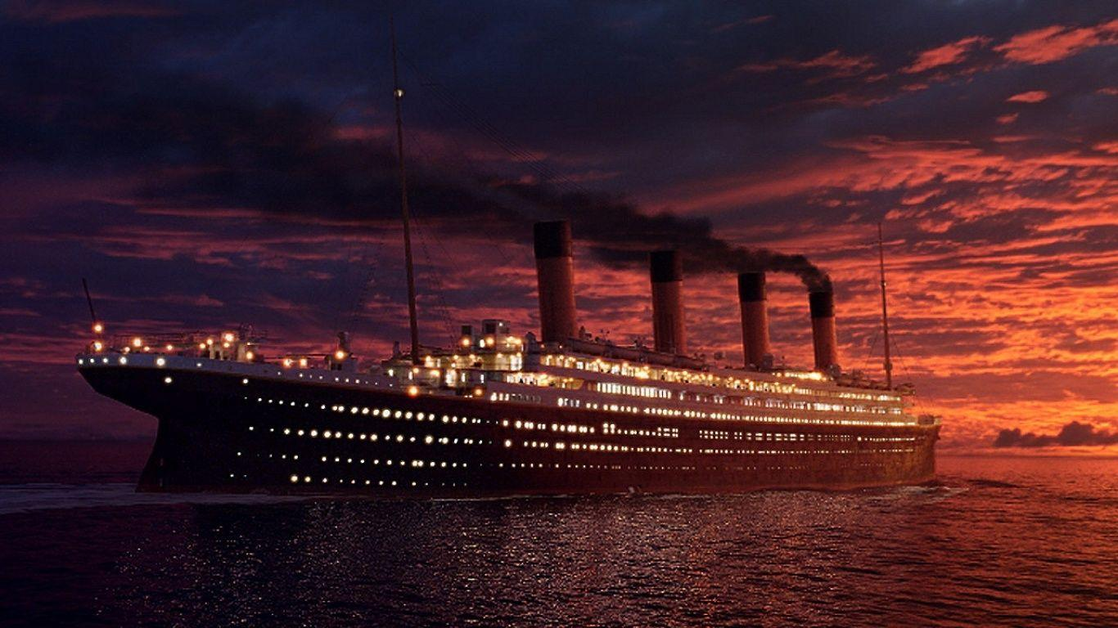
THANK YOU
DHIVYA DHARSHAN G - CB.EN.U4CCE21016
HARI KRISHNA N - CB.EN.U4CCE21036
RAJESH S - CB.EN.U4CCE21056
UTKARSH BHARADWAJ – CB.EN.U4CCE21076

